Slide 1
CI/CD for Enterprise Low-Code AI Agents
Low-code accelerates agent creation. CI/CD industrializes agent delivery.
May 2026

Slide 2



CI/CD for Enterprise Low-Code AI Agents |Why Maisa Needs CI/CD. The faster we create agents, the more important deployment governance becomes.
Taxonomy
Low-code platforms accelerate AI agent creation, but introduce new operational risks:
Manual and inconsistent deployments
Limited testing before production
Security and compliance concerns
Common issues include:
Different prompt versions between environments
Missing integrations or permissions in Production
Undocumented hotfixes performed directly in the platform UI
Inability to reproduce agent behavior during incidents
Lack of rollback mechanisms
Without a structured testing process, organizations face risks such as:
Unexpected or inconsistent responses
Hallucinations or inaccurate outputs
Failures in edge cases or uncommon scenarios
Broken integrations with external systems
Performance degradation after updates
Key concerns include:
Unauthorized access to sensitive systems or data
Excessive permissions granted to agents
Exposure of credentials, API keys, or secrets
Lack of auditability for agent changes and decisions
Non-compliance with regulatory frameworks (e.g., GDPR, internal governance policies)

Slide 3
CI/CD for Enterprise Low-Code AI Agents |Why Maisa Needs CI/CD. The faster we create agents, the more important deployment governance becomes.
Taxonomy
R1
Reliability
R2
Governance
R3
Security
Consistent behavior across environments
Full change traceability
Controlled access to integrations and secrets
DEV -> PRE -> PRO
Everytime an agent goes to PRO, it goes to Governance
Invoke an agent in DEV from an agent in PRO could happen. Reducing manual deployments reduces human errors.
R4
Quality
R5
Scalability
Automated validation before production
Managing dozens or hundreds of agents consistently
Going to PRO without tests
Managing one agent is easy…one hundred maybe not

Slide 4
CI/CD for Enterprise Low-Code AI Agents |Why Maisa Needs CI/CD. The faster we create agents, the more important deployment governance becomes.
Taxonomy
DRAFT
Challenge / Risk
 | Business Impact | CI/CD Response | Expected Outcome
Manual & Inconsistent Deployments | Configuration drift across environments, human errors, difficult rollbacks | Version control + automated deployment pipelines (DEV → PRE → PRO) | Consistent and reproducible deployments
Limited Testing Before Production | Unexpected behaviors, hallucinations, broken integrations, performance degradation | Automated validation & evaluation testing before release | Higher reliability and production confidence
Security & Compliance Concerns | Unauthorized access, secret exposure, compliance risks | Approval gates, RBAC, secrets management, auditability | Secure and compliant deployments
Reliability | Different behavior between environments | Controlled environment promotion | Consistent agent behavior
Governance | Lack of traceability | Git versioning + approval workflows | Full change visibility
Quality Assurance | Production incidents due to insufficient testing | CI quality gates | Reduced production failures
Scalability | Hard to manage multiple agents consistently | Standardized delivery model | Scalable agent operations

Slide 5
CI/CD for Enterprise Low-Code AI Agents |Proposed CI/CD Architecture
Taxonomy
Develop
CI Layer
Maisa Platform
Automated Validation & Quality Gates
Before promotion, every change is automatically validated.
Validation checks
Configuration and schema validation
Prompt quality checks
Integration verification
Evaluation testing
Benchmark datasets
Expected response validation
Hallucination and consistency testing
Security checks
Permission validation
Secrets scanning
Policy compliance
Agent Creation & Configuration
Developers, business users, or technical teams design AI agents inside Maisa.
Activities include:
Creating agents
Defining prompts and system behavior
Configuring tools, connectors, and permissions
Selecting models and runtime parameters
Goal: Rapid and collaborative agent creation.
Execution & Business Operations
Once deployed, agents run within Maisa and execute enterprise workflows.
The platform handles:
User interactions
API execution
Business process automation
Governance
Continuous Monitoring & Control
CI/CD does not end after deployment.
Organizations continuously monitor:
Technical metrics
Latency , failures, API health
AI metrics
Hallucination rate, prompt drift, response consistency
Governance
Audit trails, approval history, compliance validation
Git Repository
CD Layer
Single Source of Truth
All agent artifacts are version controlled to guarantee reproducibility.
Stored assets include:
Agent definitions and configurations
Prompt templates
Policies and permissions
Test datasets and evaluation scenarios
Controlled Deployment Across Environments
Validated agents are promoted safely through environments.
DEV → PRE → PROD
Deployment includes:
Controlled promotion process
Approval workflows for production
Automated rollback when quality drops

Slide 6
CI/CD for Enterprise Low-Code AI Agents |Why Maisa Needs CI/CD. The faster we create agents, the more important deployment governance becomes.
Taxonomy
DRAFT
Current Problem
 | Current Risk / Impact | CI/CD Solution | Expected Outcome
Unmanaged workers in Production | No visibility of what is deployed in PROD | Version-controlled deployments (Git + release tracking) | Full traceability of deployed workers
Manual deployments | Nobody knows exactly what changed or when | Automated deployment pipelines | Repeatable and auditable deployments
PRE and PROD running different Maisa versions | Workers may fail after deployment due to platform incompatibilities | Environment compatibility validation before release | Safer promotion between environments
No validation of agents / workers / prompts | Errors discovered directly in Production. Differences between different agents with the same prompt. | Automated validation + black-box testing | Fewer production incidents
Ungoverned versioning | Difficult rollback and unclear ownership of changes | Controlled versioning and release management | Reliable rollback and full change history
No controlled movement between environments | Non-audited and unsecured deployments | Approval gates + secure environment promotion | Governed and secure releases
300+ agents cannot be managed manually | Operational bottleneck and high dependency on experts | Standardized CI/CD lifecycle | Scalable agent operations

Slide 7
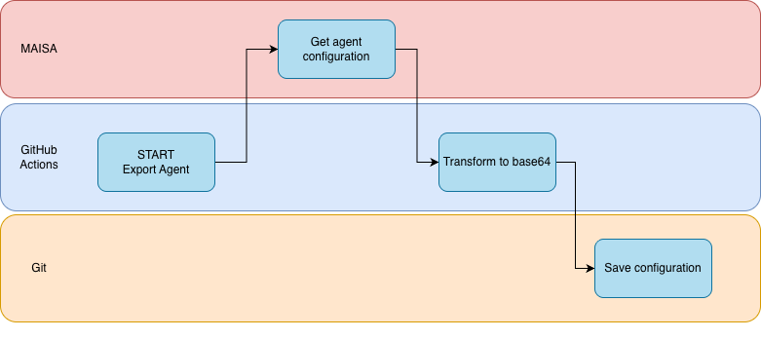
CI/CD for Enterprise Low-Code AI Agents |Current status. Done
Taxonomy
DRAFT
Export agent
Right now, we are able to export two different things from GitHub Actions:
export-config-agents.yml: Exports the worker manager config JSON (name, status, model, instructions, etc.) in a json file
export-agents.yml: Calls GET /maisa-bff/workers/{lastVersionId}/export to export the full agent binary export in a b64 file

Slide 8
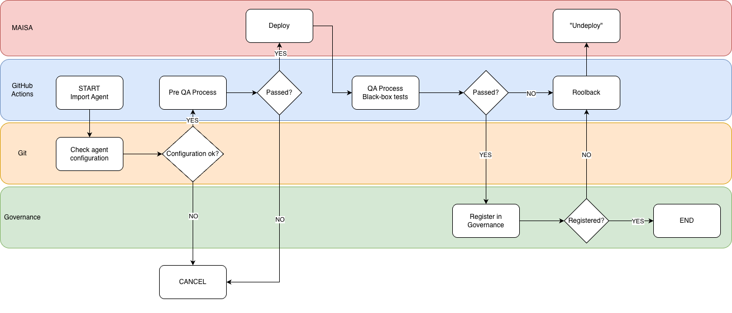
CI/CD for Enterprise Low-Code AI Agents |Current status. To DO
Taxonomy
DRAFT
Import agent
We have to implement a new workflow to import an agent in a Noxus environment.
We need the import API specification. Right now, we don’t have the API detail.

